Slide 1
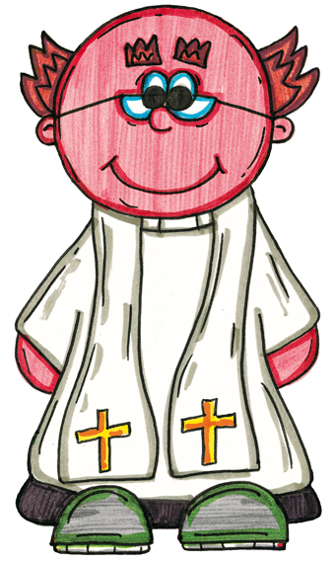
Puddles and the Happy Easter Day
Click the jigsaw to reveal the different parts of the Easter service scene inside the church.
Click here to start

Slide 2
The Reverend
Freddie Fisher
hymn
board
children
children
Easter
garden
pulpit
railings
Easter
garden
children
Puddles
pews and
congregation
pews and
congregation

Slide 3
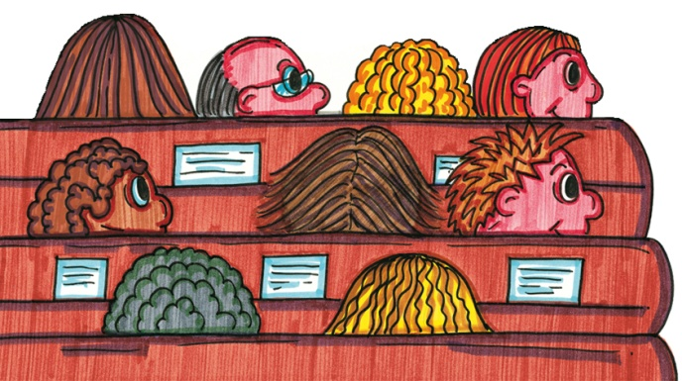
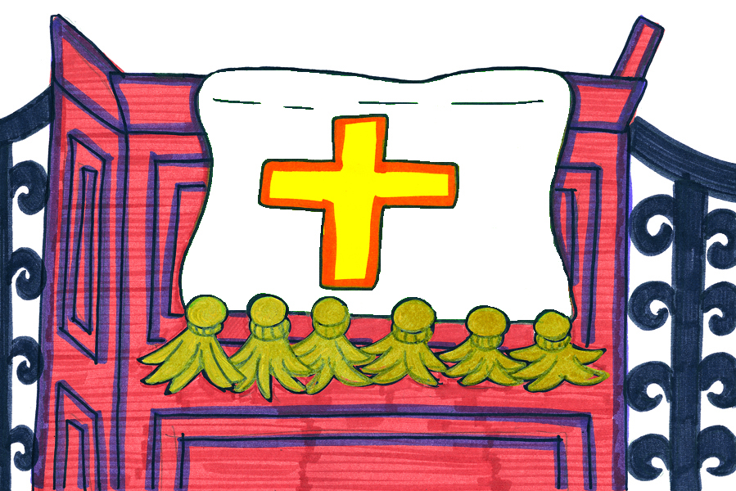
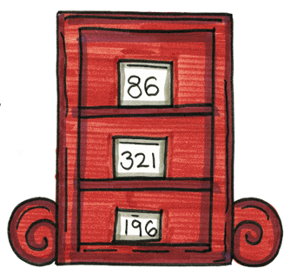
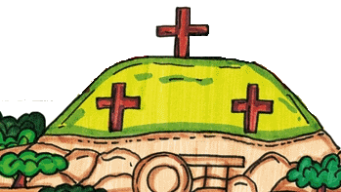
Click here to start
Can you remember
which part of the picture is under each piece of the jigsaw?

Slide 4
?
?
?
?
?
?
?
?
?
?
?
?

Slide 5
The End

